Slide 1
Week 4-1
Literature Review -
Conduction of Exploratory research
Dr. Waqar Mehmood
Professor
RSCI
RIU

Slide 2
TOC
Research process
Exploratory or formulative research
Problem definition
Literature review

Slide 3
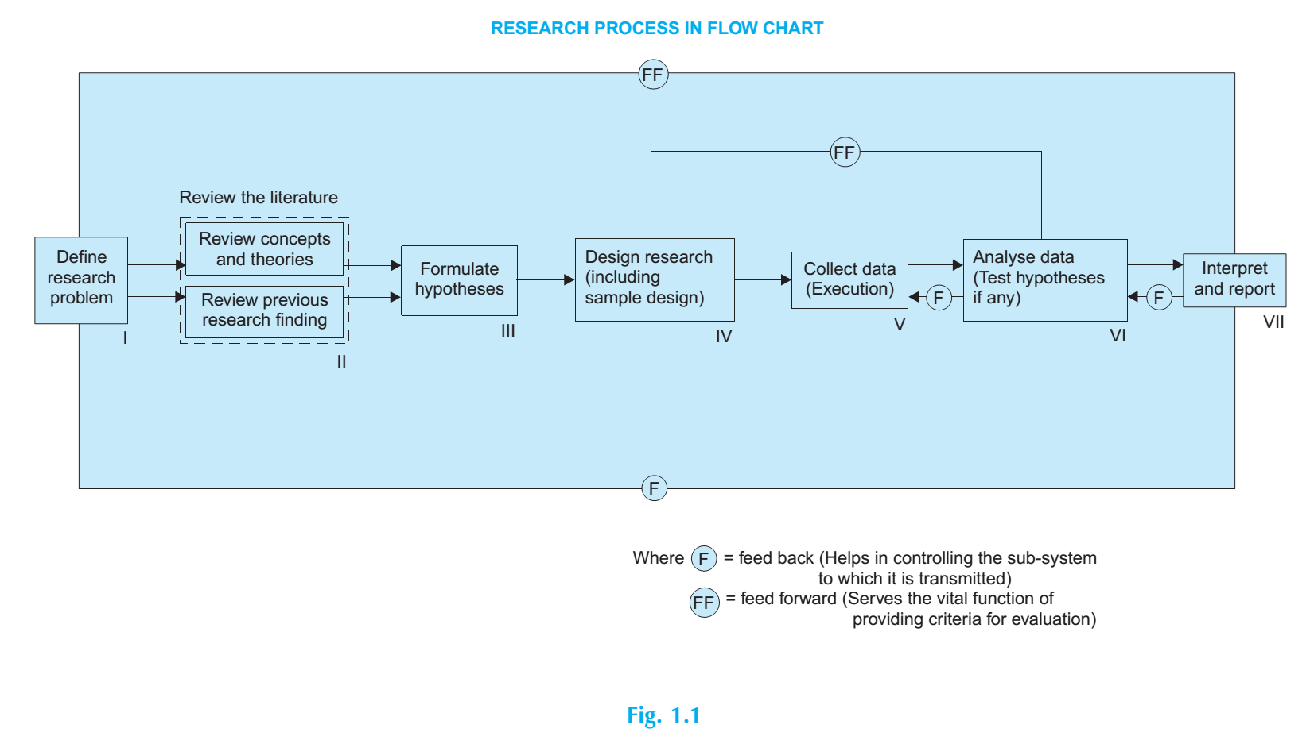

Slide 4
1. Formulating the research problem:
The best way of understanding the problem is to discuss it with one’s own colleagues or with those having some expertise in the matter.
The researcher must at the same time examine all available literature to get himself acquainted with the selected problem.
He may review two types of literature—
the conceptual literature concerning the concepts and theories, and
the empirical literature consisting of studies made earlier which are similar to the one proposed.

Slide 5
1. Steps to Define a Research Problem
Identify a broad area of interest (e.g., healthcare systems, machine learning, etc.)
Review existing literature to find knowledge gaps or unsolved issues.
Narrow down the topic to a specific context or population.
Formulate the problem statement — a concise, focused description of what will be studied.

Slide 6
Examine the literature:
Published articles are an excellent source of ideas for research questions.
They are usually at an appropriate level of specificity and suggest research questions that focus on the following:
Explore unexpected findings discovered in previous research.
Follow suggestions an author gives for future research at the end of an article.
Extend an existing explanation or theory to a new topic or setting.
Challenge findings or attempt to refute a relationship.

Slide 7
Literature Review
A literature review is based on the assumption that knowledge accumulates and that we learn from and build on what others have done.
Scientific research is a collective effort of many researchers who share their results with one another and who pursue knowledge as a community.
Today’s studies build on those of yesterday. Researchers read studies to compare, replicate, or criticize them for weaknesses.

Slide 8
Literature Review Types
Research design for exploratory research
Adhoc/Traditional Review
Systematic mapping study (SMS)
Systematic literature review (SLR)

Slide 9
Adhoc/Traditional Review
Definition:
A broad, descriptive summary of existing research on a topic — not necessarily following a strict methodology.
Purpose:
To summarize and interpret what is already known, identify gaps, and set the stage for new research.
Features:
No formal search or analysis protocol.
Focuses on theoretical and conceptual understanding.
Common in early-stage research and academic essays.

Slide 10
Systematic mapping study (SMS)/Mapping Reviews
Definition: A high-level classification of research to categorize what types of studies exist and where the research gaps lie.
Purpose: To visualize research activity trends (e.g., publication years, methodologies used).
Example: Mapping research on cloud-based systems by topic and publication year.

Slide 11
Systematic Literature Review (SLR)
Definition:
A structured, methodical, and reproducible process to identify, evaluate, and synthesize all relevant studies on a specific research question.
Purpose:
To minimize bias and provide a comprehensive evidence-based conclusion.
Features:
Predefined protocol (research question, keywords, inclusion/exclusion criteria).
Transparent search strategy and data extraction process.
Often includes tables, charts, and PRISMA diagrams.
Example:
A systematic review of AI-based scheduling algorithms from 2015–2025.

Slide 12
Where to find the Research Literature
Academic journals
Conference proceedings
Books – containing reports of original research, or collection of research articles.
Dissertations.
Government documents.
Policy reports and presented papers.
Bibliographic indexes.

Slide 13
Types of Bibliographic Indexes
Type | Description | Example
General indexes | Cover multiple disciplines | Google Scholar, Scopus, Web of Science,
Subject-specific indexes | Focus on one field | PubMed (Medicine), INSPEC (Physics, Engineering, CS)
National or regional indexes | Focus on publications within a country or region | PakMediNet (Pakistan), Indian Citation Index
Book indexes | List books, monographs, and reports | Books in Print, WorldCat
Citation indexes | Track who cited whom | Web of Science Citation Index, Scopus
Historical indexes | Cover old or archived publications | Poole’s Index to Periodical Literature

Slide 14
Example: Software reusability

Slide 15
Step 1: General Area of Interest
Software Reusability
Software reusability is a fundamental principle in software engineering that aims to reduce development cost and time by using existing software components in new systems.
It enhances productivity, reliability, and maintainability by minimizing redundant effort.

Slide 16
Step 2: Sub-Area — Reusability Measurement
To effectively promote reuse, it is important to measure how reusable a software component is. Researchers have proposed various reusability models and metrics for different paradigms — such as object-oriented, component-based, and service-oriented architectures.
These models typically assess factors like coupling, cohesion, complexity, and size.

Slide 17
Step 3: Emerging Context — Microservice-Based Systems
With the rise of microservice architecture, software systems are increasingly being developed as collections of small, independent, and reusable services.
Microservices inherently aim for reuse, scalability, and faster delivery of complex products.
However, microservices differ from traditional components and services in terms of deployment independence, technology diversity, and fine-grained functionality, which affect how their reusability should be measured.

Slide 18
Step 4: Identified Gap
Despite the central role of reuse in microservice architectures,
no specific reusability index or measurement model exists for microservice-based systems.
Existing models for OOP, component-based, and service-oriented systems do not fully capture the unique design characteristics of microservices, such as independent deployment, lightweight communication, and cross-technology integration.

Slide 19
Step 5: Problem Context
Without a dedicated microservice reusability index, it is difficult to:
Assess which microservices are most reusable across systems,
Identify redundancy or overlapping functionalities, and
Guide design improvements to maximize reuse potential.
Thus, there is a clear need to define a quantifiable framework for evaluating the reusability of microservices.

Slide 20
Step 6: Research Problem Statement
Research Problem: While software reusability has been widely studied in various paradigms, existing models and indices are not directly applicable to microservice-based systems due to their unique architectural characteristics. The absence of a microservice-specific reusability index limits the ability to quantitatively evaluate, compare, and enhance microservice reuse. Therefore, there is a need to identify relevant design factors and metrics and develop a Microservice Reusability Index (MSRI) model that can effectively measure and support reusability in microservice-based systems.

Slide 21
Step 7: Research Questions
Main Research Question
RQ1: How can the reusability of microservice-based systems be quantitatively measured using a dedicated reusability index model?
Supporting/Specific Research Questions
RQ2: What are the key design factors that influence the reusability of microservices? RQ3: Which existing reusability metrics from object-oriented, component-based, and service-oriented systems can be adapted for microservice-based systems? RQ4: How can these factors and metrics be integrated into a unified Microservice Reusability Index (MSRI) model? RQ5: How effective is the proposed MSRI model in identifying highly reusable microservices across different systems of the same problem domain?

Slide 22
Step 8: Research Objectives
Each objective corresponds to answering one or more of the above research questions.
Main Objective
To develop and validate a Microservice Reusability Index (MSRI) model that quantitatively measures and evaluates the reusability of microservice-based systems.
Specific Objectives
To conduct a systematic analysis of existing reusability models in object-oriented, component-based, and service-oriented architectures.
To identify and define key design factors (e.g., functional similarity, size, coupling, cohesion, understandability, technology) affecting microservice reusability.
To select or adapt suitable metrics from existing models for measuring the identified factors in microservice contexts.
To formulate the Microservice Reusability Index (MSRI) model, integrating the identified factors and metrics into a coherent quantitative framework.
To evaluate and validate the proposed MSRI model by applying it to sample microservice-based systems and analyzing its effectiveness in identifying reusable microservices.

Slide 23
References
C.R. Kothari, Research Methodology: Methods and Techniques.
Research Methods Lecture: Chapter 1 – Introduction, Software Systems Engineering Group, Prof. Dr. Klaus Schmid
https://chatgpt.com/c/68e21d6a-baa4-8321-96cd-0b1075915337

